Slide 3
First, an overview.

Slide 4
Finally, you don’t have to give up
all your games
and all your friends
just to play in a different room in the house.

Slide 5
This is a Steam update.

Slide 6
How to connect the dots?
Three components:

Slide 7
OS
Living-room-friendly PCs
Input

Slide 9
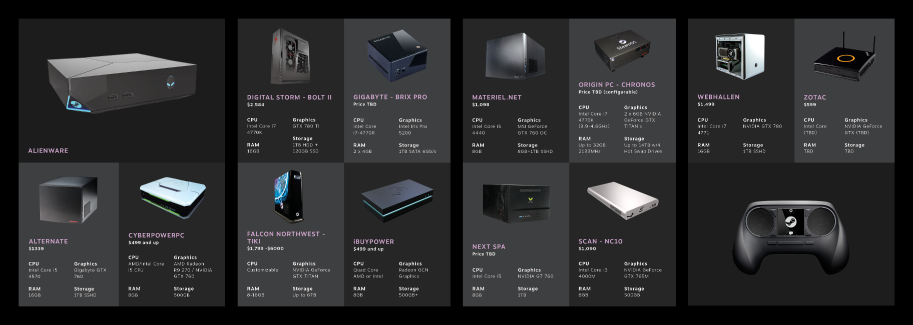

Slide 11
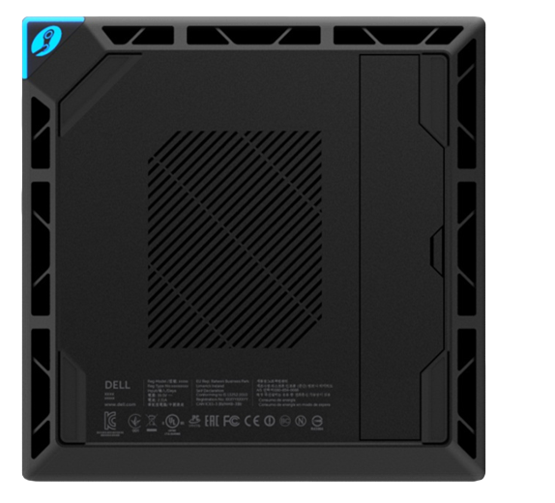
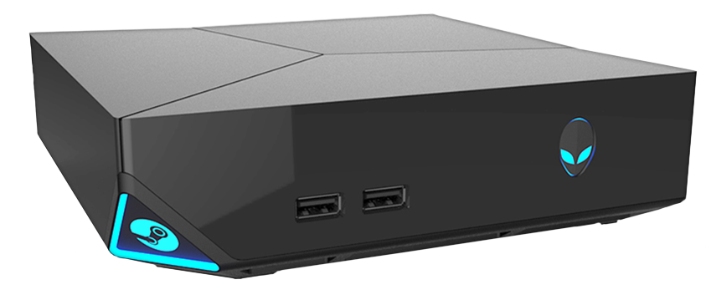
Notes:
11

Slide 14
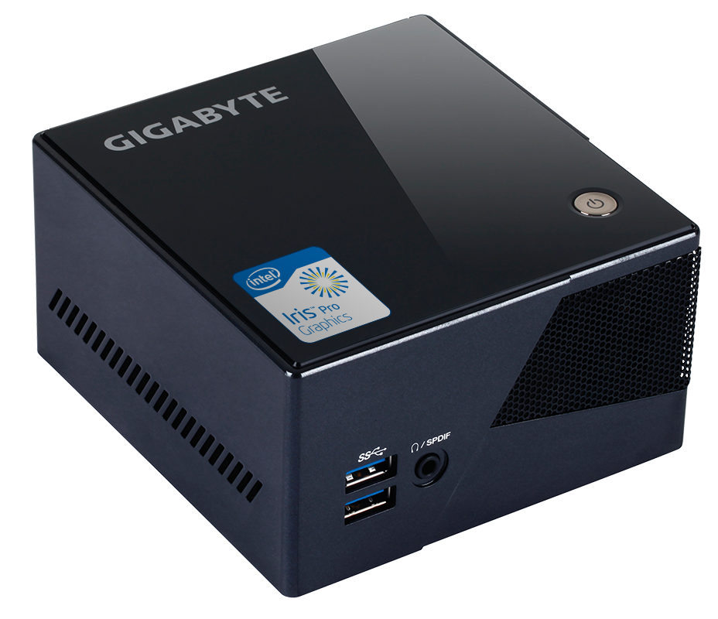

Slide 15
Banana for scale

Slide 18
F.A.Q.
@steamdevdays

Slide 19
Will there be more Steam Machines?

Slide 20
Is Valve going to make its own Steam Machine?

Slide 21
How will customers know which Steam Machine to buy?

Slide 22
What if someone builds a really low spec machine?

Slide 23
Can customers build their own
Steam Machines?

Slide 24
How will developers know what spec to build for?

Slide 25
Will Steam Controllers be sold separately?

Slide 26
What’s up with the in-home streaming thing?

Slide 27
What have you learned from the Beta so far?

Slide 28
What’s left to do in the OS before you ship?

Slide 29
When you say “Open”, what do you mean?

Slide 30
Will there be exclusive titles?

Slide 31
Why Linux?!

Slide 32
When are you actually launching?

Slide 33
Is your goal to compete with the consoles?

Slide 34
When should I port my games to Linux?

Slide 35
What dev kits and dev tools are available?

Slide 36
Your Questions!

Slide 38
What is the Steam hardware/OS group going to do next?

Slide 39
Are you hiring?

Slide 40
When can we get a Steam Machine?

Slide 41
Today!

Slide 43
Also!

Slide 44
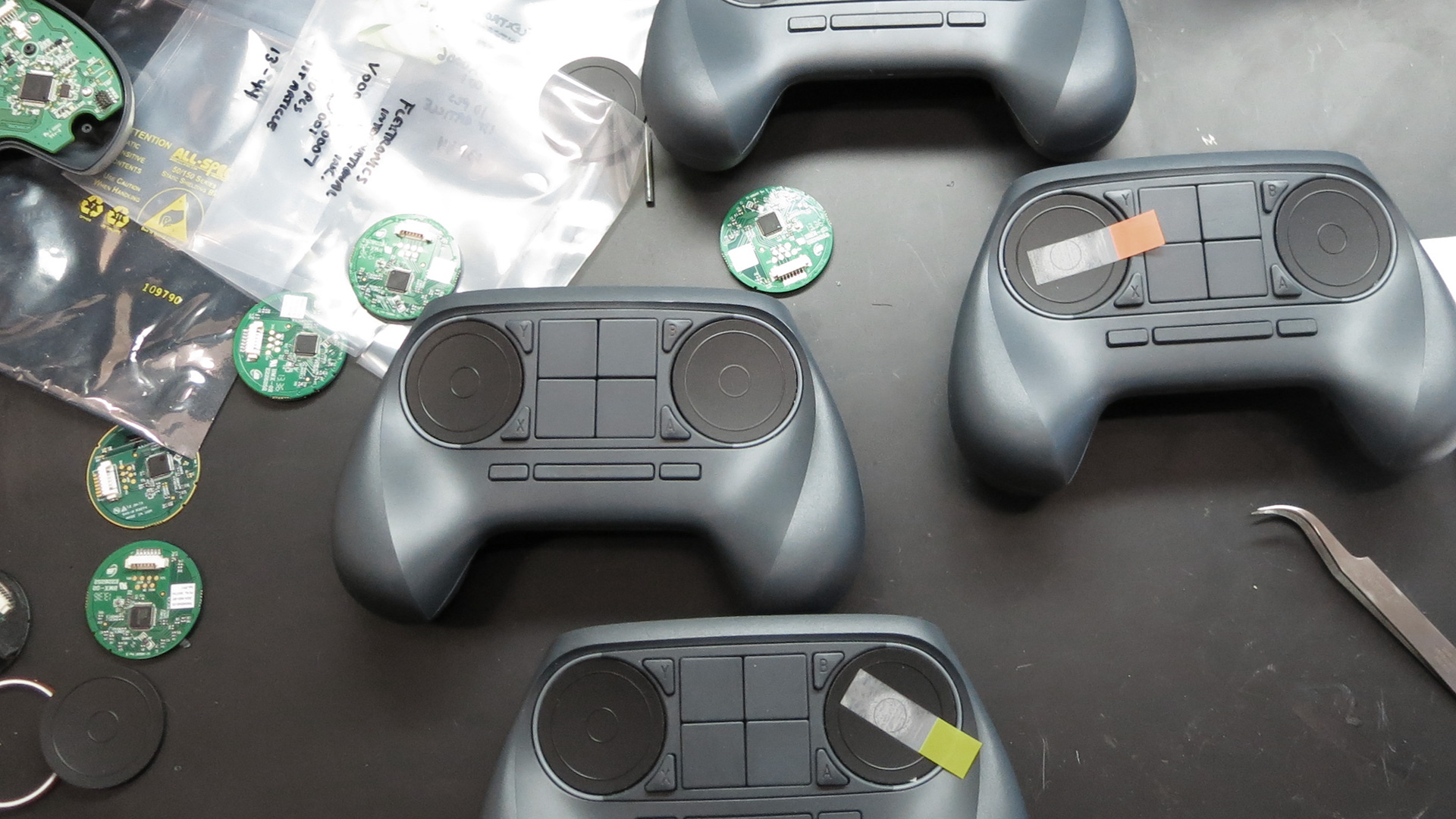

Slide 45
Thanks.
(Come talk to us!)

