Slide 1
Beyond Porting
How Modern OpenGL can Radically Reduce Driver Overhead

Slide 2
Who are we?
Cass Everitt, NVIDIA Corporation
John McDonald, NVIDIA Corporation

Slide 3
What will we cover?
Dynamic Buffer Generation
Efficient Texture Management
Increasing Draw Call Count

Slide 4
Dynamic Buffer Generation
Problem
Our goal is to generate dynamic geometry directly in place.
It will be used one time, and will be completely regenerated next frame.
Particle systems are the most common example
Vegetation / foliage also common

Slide 5
Typical Solution
void UpdateParticleData(uint _dstBuf) {
BindBuffer(ARRAY_BUFFER, _dstBuf);
access = MAP_UNSYNCHRONIZED | MAP_WRITE_BIT;
for particle in allParticles {
dataSize = GetParticleSize(particle);
void* dst = MapBuffer(ARRAY_BUFFER, offset, dataSize, access);
(*(Particle*)dst) = *particle;
UnmapBuffer(ARRAY_BUFFER);
offset += dataSize;
}
};
// Now render with everything.

Slide 6
The horror
void UpdateParticleData(uint _dstBuf) {
BindBuffer(ARRAY_BUFFER, _dstBuf);
access = MAP_UNSYNCHRONIZED | MAP_WRITE_BIT;
for particle in allParticles {
dataSize = GetParticleSize(particle);
void* dst = MapBuffer(ARRAY_BUFFER, offset, dataSize, access);
(*(Particle*)dst) = *particle;
UnmapBuffer(ARRAY_BUFFER);
offset += dataSize;
}
};
// Now render with everything.
This is so slow.

Slide 7
Driver interlude
First, a quick interlude on modern GL drivers
In the application (client) thread, the driver is very thin.
It simply packages work to hand off to the server thread.
The server thread does the real processing
It turns command sequences into push buffer fragments.

Slide 8
Healthy Driver Interaction Visualized
Application
Driver (Client)
Driver (Server)
GPU
State Change
Thread separator
Action Method (draw, clear, etc)
Component separator
Present

Slide 9
MAP_UNSYNCHRONIZED
Avoids an application-GPU sync point (a CPU-GPU sync point)
But causes the Client and Server threads to serialize
This forces all pending work in the server thread to complete
It’s quite expensive (almost always needs to be avoided)

Slide 10
Healthy Driver Interaction Visualized
Application
Driver (Client)
Driver (Server)
GPU
State Change
Thread separator
Action Method (draw, clear, etc)
Component separator
Present

Slide 11
Client-Server Stall of Sadness
Application
Driver (Client)
Driver (Server)
GPU
State Change
Thread separator
Action Method (draw, clear, etc)
Component separator
Present

Slide 12
It’s okay
Q: What’s better than mapping in an unsynchronized manner?
A: Keeping around a pointer to GPU-visible memory forever.
Introducing: ARB_buffer_storage

Slide 13
ARB_buffer_storage
Conceptually similar to ARB_texture_storage (but for buffers)
Creates an immutable pointer to storage for a buffer
The pointer is immutable, the contents are not.
So BufferData cannot be called—BufferSubData is still okay.
Allows for extra information at create time.
For our usage, we care about the PERSISTENT and COHERENT bits.
PERSISTENT: Allow this buffer to be mapped while the GPU is using it.
COHERENT: Client writes to this buffer should be immediately visible to the GPU.
http://www.opengl.org/registry/specs/ARB/buffer_storage.txt

Slide 14
ARB_buffer_storage cont’d
Also affects the mapping behavior (pass persistent and coherent bits to MapBufferRange)
Persistently mapped buffers are good for:
Dynamic VB / IB data
Highly dynamic (~per draw call) uniform data
Multi_draw_indirect command buffers (more on this later)
Not a good fit for:
Static geometry buffers
Long lived uniform data (still should use BufferData or BufferSubData for this)

Slide 15
Armed with persistently mapped buffers
// At the beginning of time
flags = MAP_WRITE_BIT | MAP_PERSISTENT_BIT | MAP_COHERENT_BIT;
BufferStorage(ARRAY_BUFFER, allParticleSize, NULL, flags);
mParticleDst = MapBufferRange(ARRAY_BUFFER, 0, allParticleSize, flags);
mOffset = 0;
// allParticleSize should be ~3x one frame’s worth of particles
// to avoid stalling.
Notes:
mParticleDst should be treated as a ring buffer.

Slide 16
Update Loop (old and busted)
void UpdateParticleData(uint _dstBuf) {
BindBuffer(ARRAY_BUFFER, _dstBuf);
access = MAP_UNSYNCHRONIZED | MAP_WRITE_BIT;
for particle in allParticles {
dataSize = GetParticleSize(particle);
void* dst = MapBuffer(ARRAY_BUFFER, offset, dataSize, access);
(*(Particle*)dst) = *particle;
offset += dataSize;
UnmapBuffer(ARRAY_BUFFER);
}
};
// Now render with everything.

Slide 17
Update Loop (new hotness)
void UpdateParticleData() {
for particle in allParticles {
dataSize = GetParticleSize(particle);
mParticleDst[mOffset] = *particle;
mOffset += dataSize; // Wrapping not shown
}
};
// Now render with everything.

Slide 18
Test App
Notes:
Lamest point sprites imaginable
Triangles, but specified as 2-D coordinates. Spaced for obviousness

Slide 19
Performance results
160,000 point sprites
Specified in groups of 6 vertices (one particle at a time)
Synthetic (naturally)
Method | FPS | Particles / S
Map(UNSYNCHRONIZED) | 1.369 | 219,040
BufferSubData | 17.65 | 2,824,000
D3D11 Map(NO_OVERWRITE) | 20.25 | 3,240,000
Notes:
Could obviously improve efficiency by only calling regular Map once per frame. This performance is worse than BufferSubData, but better Map(UNSYNCHRONIZED otherwise).

Slide 20
Performance results
160,000 point sprites
Specified in groups of 6 vertices (one particle at a time)
Synthetic (naturally)
Room for improvement still, but much, much better.
Method | FPS | Particles / S
Map(UNSYNCHRONIZED) | 1.369 | 219,040
BufferSubData | 17.65 | 2,824,000
D3D11 Map(NO_OVERWRITE) | 20.25 | 3,240,000
Map(COHERENT|PERSISTENT) | 79.9 | 12,784,000
Notes:
Could obviously improve efficiency by only calling regular Map once per frame. This performance is worse than BufferSubData, but better Map(UNSYNCHRONIZED otherwise).

Slide 21
The other shoe
You are responsible for not stomping on data in flight.
Why 3x?
1x: What the GPU is using right now.
2x: What the driver is holding, getting ready for the GPU to use.
3x: What you are writing to.
3x should ~ guarantee enough buffer room*…
Use fences to ensure that rendering is complete before you begin to write new data.

Slide 22
Fencing
Use FenceSync to place a new fence.
When ready to scribble over that memory again, use ClientWaitSync to ensure that memory is done.
ClientWaitSync will block the client thread until it is ready
So you should wrap this function with a performance counter
And complain to your log file (or resize the underlying buffer) if you frequently see stalls here
For complete details on correct management of buffers with fencing, see Efficient Buffer Management [McDonald 2012]

Slide 23
Efficient Texture Management
Or “how to manage all texture memory myself”

Slide 24
Problem
Changing textures breaks batches.
Not all texture data is needed all the time
Texture data is large (typically the largest memory bucket for games)
Bindless solves this, but can hurt GPU performance
Too many different textures can fall out of TexHdr$
Not a bindless problem per se

Slide 25
Terminology
Reserve – The act of allocating virtual memory
Commit – Tying a virtual memory allocation to a physical backing store (Physical memory)
Texture Shape – The characteristics of a texture that affect its memory consumption
Specifically: Height, Width, Depth, Surface Format, Mipmap Level Count

Slide 26
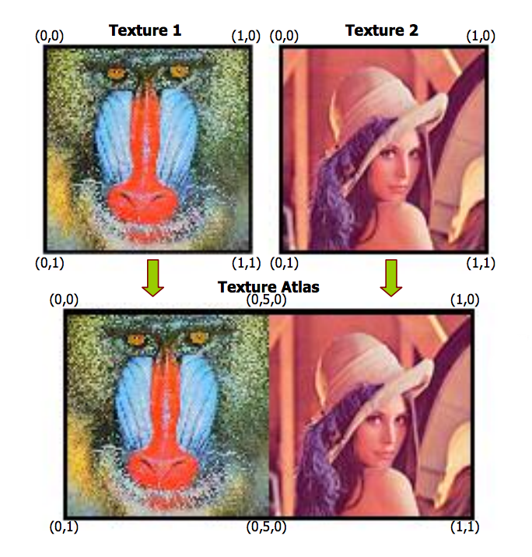
Old Solution
Texture Atlases
Problems
Can impact art pipeline
Texture wrap, border filtering
Color bleeding in mip maps

Slide 27
Texture Arrays
Introduced in GL 3.0, and D3D 10.
Arrays of textures that are the same shape and format
Typically can contain many “layers” (2048+)
Filtering works as expected
As does mipmapping!

Slide 28
Sparse Bindless Texture Arrays
Organize loose textures into Texture Arrays.
Sparsely allocate Texture Arrays
Introducing ARB_sparse_texture
Consume virtual memory, but not physical memory
Use Bindless handles to deal with as many arrays as needed!
Introducing ARB_bindless_texture
uncommitted layer
uncommitted layer
uncommitted layer

Slide 29
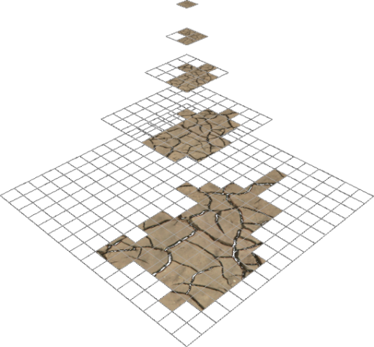
ARB_sparse_texture
Applications get fine-grained control of physical memory for textures with large virtual allocations
Inspired by Mega Texture
Primary expected use cases:
Sparse texture data
Texture paging
Delayed-loading assets
http://www.opengl.org/registry/specs/ARB/sparse_texture.txt

Slide 30
ARB_bindless_texture
Textures specified by GPU-visible “handle” (really an address)
Rather than by name and binding point
Can come from ~anywhere
Uniforms
Varying
SSBO
Other textures
Texture residency also application-controlled
Residency is “does this live on the GPU or in sysmem?”
https://www.opengl.org/registry/specs/ARB/bindless_texture.txt

Slide 31
Advantages
Artists work naturally
No preprocessing required (no bake-step required)
Although preprocessing is helpful if ARB_sparse_texture is unavailable
Reduce or eliminate TexHdr$ thrashing
Even as compared to traditional texturing
Programmers manage texture residency
Works well with arbitrary streaming
Faster on the CPU
Faster on the GPU

Slide 32
Disadvantages
Texture addresses are now structs (96 bits).
64 bits for bindless handle
32 bits for slice index (could reduce this to 10 bits at a perf cost)
ARB_sparse_texture implementations are a bit immature
Early adopters: please bring us your bugs.
ARB_sparse_texture requires base level be a multiple of tile size
(Smaller is okay)
Tile size is queried at runtime
Textures that are power-of-2 should almost always be safe.

Slide 33
Implementation Overview
When creating a new texture…
Check to see if any suitable texture array exists
Texture arrays can contain a large number of textures of the same shape
Ex. Many TEXTURE_2Ds grouped into a single TEXTURE_2D_ARRAY
If no suitable texture, create a new one.

Slide 34
Texture Container Creation (example)
GetIntegerv( MAX_SPARSE_ARRAY_TEXTURE_LAYERS, maxLayers );
Choose a reasonable size (e.g. array size ~100MB virtual )
If new internalFormat, choose page size
GetInternalformativ( …, internalformat, NUM_VIRTUAL_PAGE_SIZES, 1, &numIndexes);
Note: numIndexes can be 0, so have a plan
Iterate, select suitable pageSizeIndex
BindTexture( TEXTURE_2D_ARRAY, newTexArray );
TexParameteri( TEXTURE_SPARSE, TRUE );
TexParameteri( VIRTUAL_PAGE_SIZE_INDEX, pageSizeIndex );
Allocate the texture’s virtual memory using TexStorage3D

Slide 35
Specifying Texture Data
Using the located/created texture array from the previous step
Allocate a layer as the location of our data
For each mipmap level of the allocated layer:
Commit the entire mipmap level (using TexPageCommitment)
Specify actual texel data as usual for arrays
gl(Compressed|Copy|)TexSubImage3D
PBO updates are fine too
uncommitted layer
free slice
free slice
Allocated layer

Slide 36
Freeing Textures
To free the texture, reverse the process:
Use TexPageCommitment to mark the entire layer (slice) as free.
Do once for each mipmap level
Add the layer to the free list for future allocation
uncommitted layer
free slice
free slice
uncommitted layer
Freed layer

Slide 37
Combining with Bindless to eliminate binds
At container create time:
Specify sampling parameters via SamplerParameter calls first
Call GetTextureSamplerHandleARB to return a GPU-visible pointer to the texture+sampler container
Call MakeTextureHandleResident to ensure the resource lives on the GPU
At delete time, call MakeTextureHandleNonResident
With bindless, you explicitly manage the GPU’s working set
Notes:
With bindless, sampler* can be passed around like any other 64-bit integer.
Note that if MakeTextureHandleResident succeeds, the texture is definitely on the GPU
But that MakeTextureHandleNonResident only tells the driver that it may choose to free the GPU memory consumed by the texture.

Slide 38
Using texture data in shaders
When a texture is needed with the default sampling parameters
Create a GLSL-visible TextureRef object:
struct TextureRef { sampler2DArray container; float slice; };
When a texture is needed with custom sampling parameters
Create a separate sampler object for the shader with the parameters
Create a bindless handle to the pair using GetTextureSamplerHandle, then call MakeTextureHandleResident with the new value
And fill out a TextureRef as above for usage by GLSL
Notes:
M

Slide 39
C++ Code
Basic implementation (some details missing)
BSD licensed (use as you will)
https://github.com/nvMcJohn/apitest/blob/pdoane_newtests/sparse_bindless_texarray.h
https://github.com/nvMcJohn/apitest/blob/pdoane_newtests/sparse_bindless_texarray.cpp

Slide 40
Increasing Draw Call Count
Let’s draw all the calls!

Slide 41
All the Draw Calls!
Problem
You want more draw calls of smaller objects.
D3D is slow at this.
Naïve GL is faster than D3D, but not fast enough.

Slide 42
XY Problem
Y: How can I have more draw calls?
X: You don’t really care if it’s more draw calls, right?
Really what you want is to be able to draw more small geometry groupings. More objects.

Slide 43
Well why didn’t you just say so??
First, some background.
What makes draw calls slow?
Real world API usage
Draw Call Cost Visualization

Slide 44
Some background
What causes slow draw calls?
Validation is the biggest bucket (by far).
Pre-validation is “difficult”
“Every application does the same things.”
Not really. Most applications are in completely disjoint states
Try this experiment: What is important to you?
Now ask your neighbor what’s important to him.

Slide 45
Why is prevalidation difficult?
The GPU is an exceedingly complex state machine.
(Honestly, it’s probably the most complex state machine in all of CS)
Any one of those states may have a problem that requires WAR
Usually the only problem is overall performance
But sometimes not. ☹
There are millions of tests covering NVIDIA GPU functionality.
Notes:
Speed and power come from fixed-functionality.
But that means that the GPU is rigid in behaviors.

Slide 46
FINE.
How can app devs mitigate these costs?
Minimize state changes.
All state changes are not created equal!
Cost of a draw call: Small fixed cost + Cost of validation of changed state

Slide 47
Feels limiting…
Artists want lots of materials, and small amounts of geometry
Even better: What if artists just didn’t have to care about this?
Ideal Programmer->Artist Interaction
“You make pretty art. I’ll make it fit.”

Slide 48
Relative costs of State Changes
In decreasing cost…
Render Target
Program
ROP
Texture Bindings
Vertex Format
UBO Bindings
Vertex Bindings
Uniform Updates
~60K / s
~300K / s
~1.5M / s
~10M / s
Note: Not to scale

Slide 49
Real World API frequency
API usage looks roughly like this…
Increasing Frequency of Change
Render Target (scene)
Per Scene Uniform Buffer + Textures
IB / VB and Input Layout
Shader (Material)
Per-material Uniform Buffer + Textures
Per-object Uniform Buffer + Textures
Per-piece Uniform Buffer + Textures
Draw

Slide 50
Draw Calls visualized
Render Target
Texture
Uniform Updates
Program
UBO Binding
Draw
ROP
Vertex Format

Slide 51
Draw Calls visualized (cont’d)
Read down, then right
Black—no change
Render Target
Texture
Uniform Updates
Program
UBO Binding
Draw
ROP
Vertex Format

Slide 52
Goals
Let’s minimize validation costs without affecting artists
Things we need to be fast (per app call frequency):
Uniform Updates and binding
Texture Updates and binding
These happen most often in app, ergo driving them to ~0 should be a win.

Slide 53
Textures
Using Sparse Bindless Texture Arrays (as previously described) solves this.
All textures are set before any drawing begins
(No need to change textures between draw calls)
Note that from the CPU’s perspective, just using bindless is sufficient.
That was easy.

Slide 54
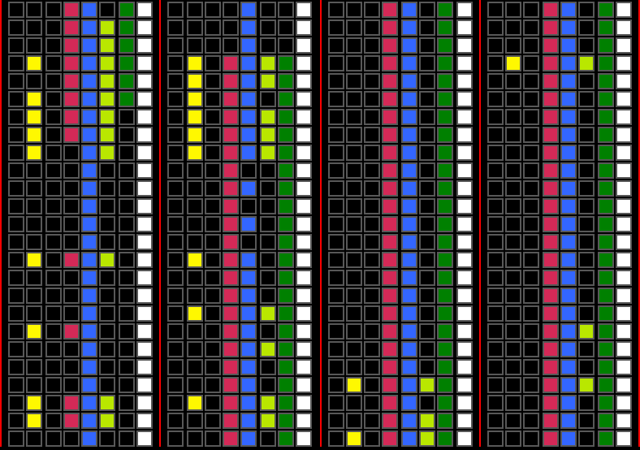
Eliminating Texture Binds -- visualized
Increasing Frequency of Change
Render Target (scene)
Per Scene Uniform Buffer + Textures
IB / VB and Input Layout
Shader (Material)
Per-material Uniform Buffer + Textures
Per-object Uniform Buffer + Textures
Per-piece Uniform Buffer + Textures
Draw
Render Target
Texture
Uniform Updates
Program
UBO Binding
Draw
ROP
Vertex Format

Slide 55
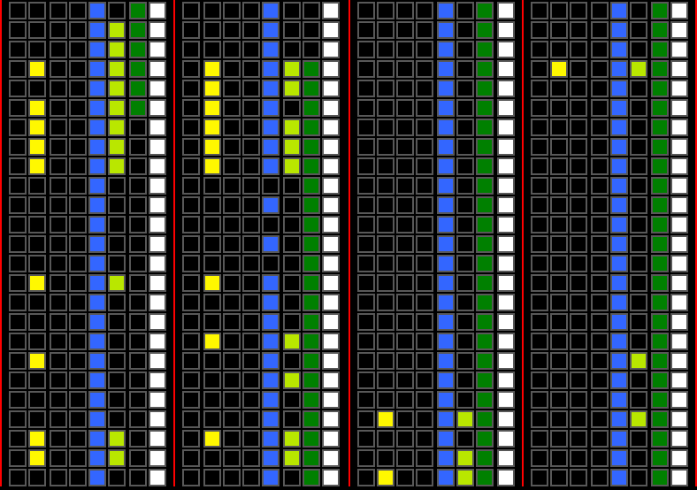
Boom!
Increasing Frequency of Change
Render Target (scene)
Per Scene Uniform Buffer
IB / VB and Input Layout
Shader (Material)
Per-material Uniform Buffer
Per-object Uniform Buffer
Per-piece Uniform Buffer
Draw
Render Target
Texture
Uniform Updates
Program
UBO Binding
Draw
ROP
Vertex Format

Slide 56
Buffer updates (old and busted)
Typical Scene Graph Traversal for obj in visibleObjectSet { update(buffer, obj); draw(obj); }

Slide 57
Buffer updates (new hotness)
Typical Scene Graph Traversal for obj in visibleObjectSet { update(bufferFragment, obj); } for obj in visibleObjectSet { draw(obj); }

Slide 58
bufferFragma-wha?
Rather than one buffer per object, we share UBOs for many objects.
ie, given struct ObjectUniforms { /* … */ }; // Old (probably not explicitly instantiated, // just scattered in GLSL) ObjectUniforms uniformData; // New ObjectUniforms uniformData[ObjectsPerKickoff];
Use persistent mapping for even more win here!
For large amounts of data (bones) consider SSBO.
Introducing ARB_shader_storage_buffer_object

Slide 59
SSBO?
Like “large” uniform buffer objects.
Minimum required size to claim support is 16M.
Accessed like uniforms in shader
Support for better packing (std430)
Caveat: They are typically implemented in hardware as textures (and can introduce dependent texture reads)
Just one of a laundry list of things to consider, not to discourage use.
http://www.opengl.org/registry/specs/ARB/shader_storage_buffer_object.txt

Slide 60
Eliminating Buffer Update Overhead
Increasing Frequency of Change
Render Target (scene)
Per Scene Uniform Buffer
IB / VB and Input Layout
Shader (Material)
Per-material Uniform Buffer
Per-object Uniform Buffer
Per-piece Uniform Buffer
Draw
Render Target
Texture
Uniform Updates
Program
UBO Binding
Draw
ROP
Vertex Format

Slide 61
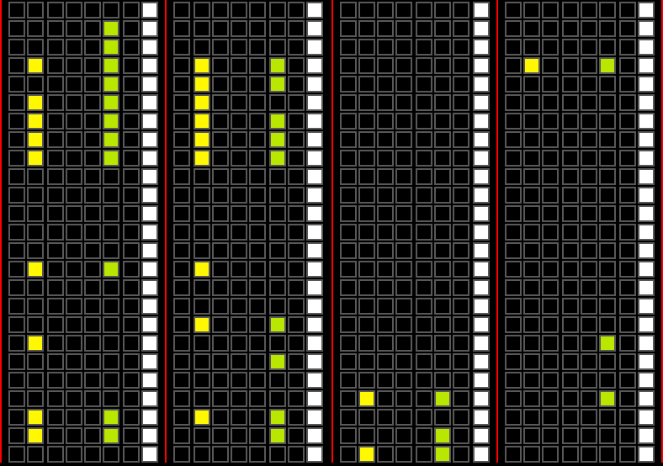
Sweet!
Increasing Frequency of Change
Render Target (scene)
IB / VB and Input Layout
Shader (Material)
Draw ( * each object )
Hrrrrmmmmmm….
Render Target
Texture
Uniform Updates
Program
UBO Binding
Draw
ROP
Vertex Format

Slide 62
So now…
It’d be awesome if we could do all of those kickoffs at once.
Validation is already only paid once
But we could just pay the constant startup cost once.
If only…….

Slide 63
So now…
It’d be awesome if we could do all of those kickoffs at once.
Validation is already only paid once
But we could just pay the constant startup cost once.
If only…….
Introducing ARB_multi_draw_indirect

Slide 64
ARB_multi_draw_indirect
Allows you to specify parameters to draw commands from a buffer.
This means you can generate those parameters wide (on the CPU)
Or even on the GPU, via compute program.
http://www.opengl.org/registry/specs/ARB/multi_draw_indirect.txt

Slide 65
ARB_multi_draw_indirect cont’d
void MultiDrawElementsIndirect(enum mode,
enum type
const void* indirect,
sizei primcount,
sizei stride);

Slide 66
ARB_multi_draw_indirect cont’d
const ubyte * ptr = (const ubyte *)indirect;
for (i = 0; i < primcount; i++) {
DrawArraysIndirect(mode,
(DrawArraysIndirectCommand*)ptr);
if (stride == 0)
{
ptr += sizeof(DrawArraysIndirectCommand);
} else {
ptr += stride;
}
}

Slide 67
DrawArraysIndirectCommand
typedef struct {
uint count;
uint primCount;
uint first;
uint baseInstance;
} DrawArraysIndirectCommand;

Slide 68
Knowing which shader data is mine
Use ARB_shader_draw_parameters, a necessary companion to ARB_multi_draw_indirect
Adds a builtin to the VS: DrawID (InstanceID already available)
This tells you which command of a MultiDraw command is being executed.
When not using MultiDraw, the builtin is specified to be 0.
Caveat: Right now, you have to pass this down to other shader stages as an interpolant.
Hoping to have that rectified via ARB or EXT extension “real soon now.”
http://www.opengl.org/registry/specs/ARB/shader_draw_parameters.txt

Slide 69
Applying everything
CPU Perf is massively better
5-30x increase in number of distinct objects / s
Interaction with driver is decreased ~75%
Note: GPU perf can be affected negatively (although not too badly)
As always: Profile, profile, profile.

Slide 70
Previous Results
Render Target
Texture
Uniform Updates
Program
UBO Binding
Draw
ROP
Vertex Format

Slide 71
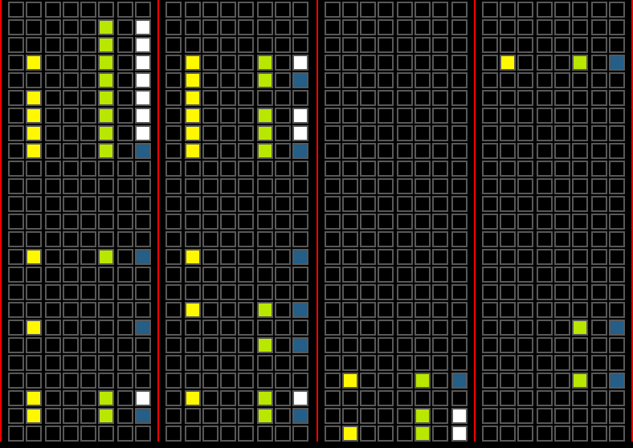
Visualized Results
Render Target
Texture
Uniform Updates
Program
UBO Binding
Draw
ROP
Vertex Format
MultiDraw

Slide 72
Where we came from
Render Target
Texture
Uniform Updates
Program
UBO Binding
Draw
ROP
Vertex Format

Slide 73
Conclusion
Go forth and work magnify.

Slide 74
Questions?
jmcdonald at nvidia dot com
cass at nvidia dot com

